Slide 1

Brief Summary Presentation
Gemini Corp.
"Intelligent Healthcare Solutions"
2026
One Sansome Street, Suite 1400
San Francisco, CA 94104
(415) 334-5600
Founder and CEO: Neal Solomon
www.geminimedicalsolutions.com
info@geminimedicalsolutions.com

Slide 2
HEALTHCARE CRISIS
Challenges of 20th Century Medicine
Americans and Western nation citizens face unprecedented levels of chronic disease. Obesity has reached epidemic proportions, cardiovascular disease remains the leading cause of death, and cancer strikes younger populations than ever before.
Modern medicine has been fundamentally reactive – waiting until patients fall ill before diagnosing and prescribing generic therapies. Despite spending far more on healthcare than other nations, the American medical system achieves significantly worse outcomes.
2x
40%
#1
Healthcare Spending
Chronic Disease Rate
Healthcare Cost
Per capita vs. comparable nations
Adults with one or more conditions
Most expensive system globally
The old medical paradigm is relatively inefficient, inequitable, and unproductive – demanding a fundamental transformation.

Slide 3
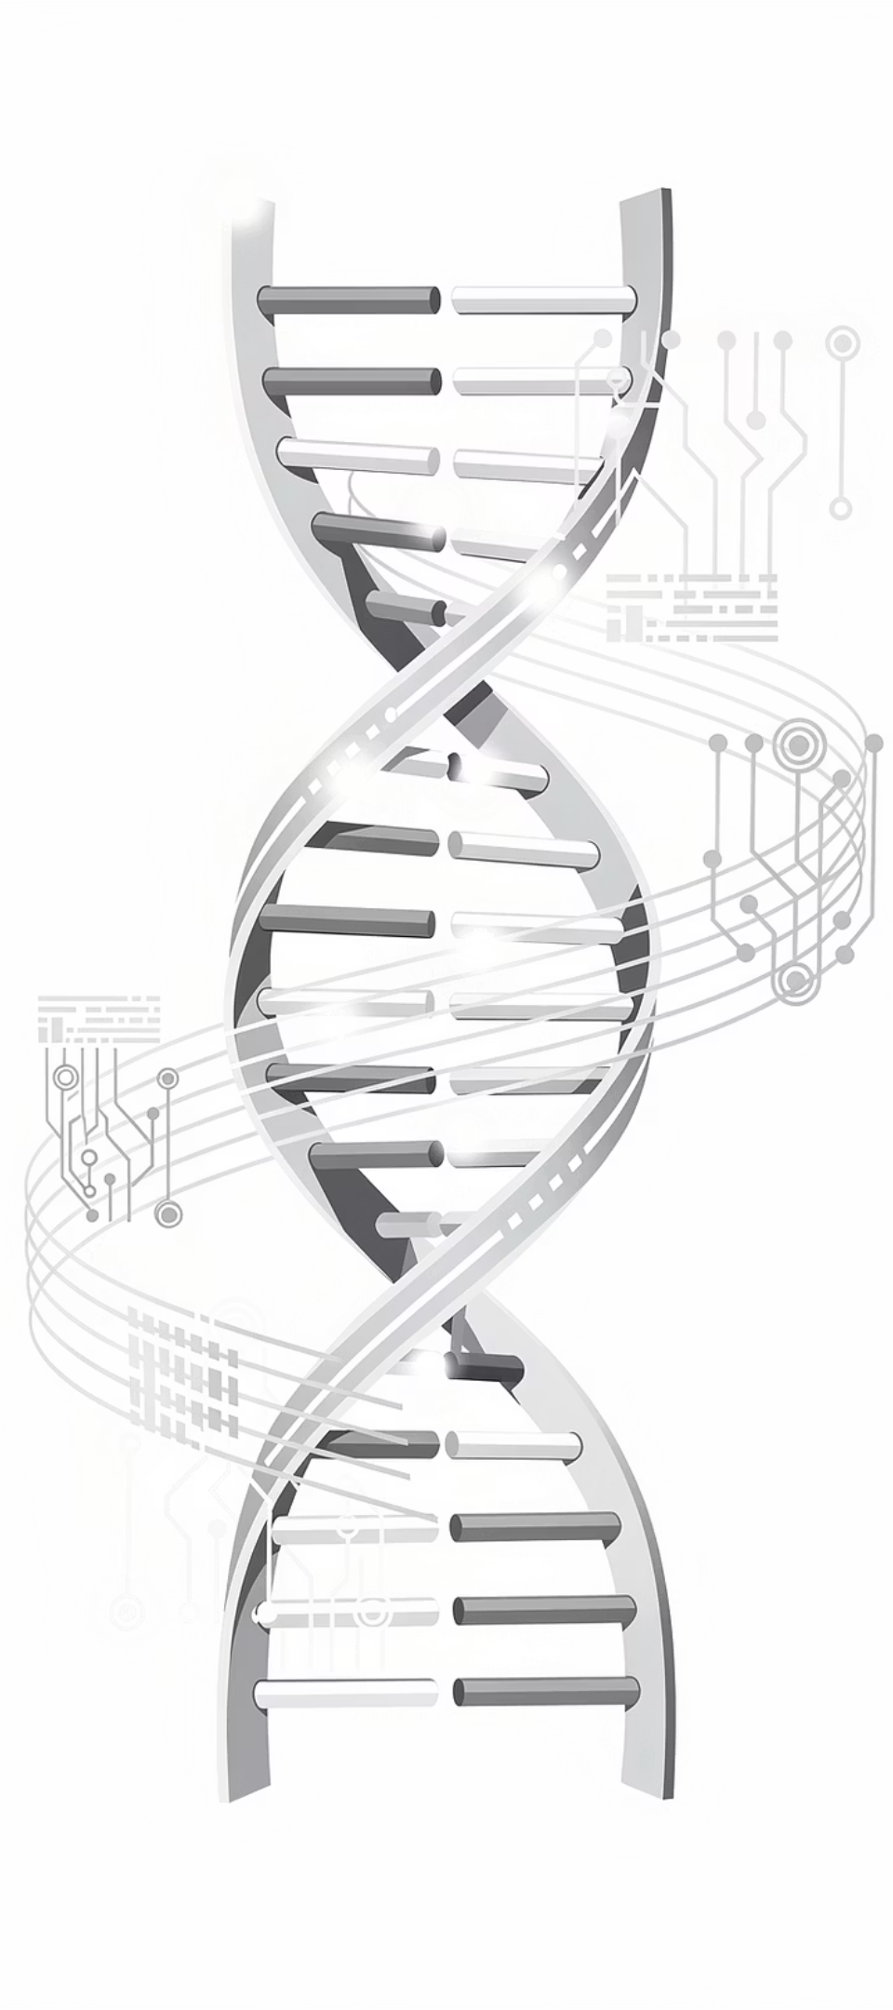

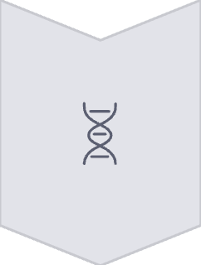


NEW ERA
Need for a New Paradigm in Medicine
Revolutionary technologies are converging to enable medicine that is information-rich, predictive, and precisely tailored to each individual patient.
Genomics & Proteomics
Deep molecular analysis of patient data enables unprecedented precision in understanding disease mechanisms
Computational Analytics
Next-generation bioinformatics processes vast datasets to identify patterns invisible to traditional methods
Artificial Intelligence
Powerful AI tools analyze complex medical data, revealing insights that transform diagnosis and treatment
In the new paradigm for medicine, medical modeling becomes the centerpiece of the physician's practice.

Slide 4

Medical Modeling Enables Personalized Medicine
Medical modeling – often called digital twins – revolutionizes healthcare by identifying solutions uniquely suited to each patient's health challenges.
When illness strikes, physicians leverage precision molecular data from genetic sequencing and biomarker analysis to diagnose with unprecedented accuracy.
1
2
3
Molecular Data Collection
Precision Diagnosis
Individualized Modeling
Comprehensive genetic and biomarker profiling of the patient
AI-powered analysis identifies illness with molecular-level accuracy
Custom medical models analyze the patient's unique disease profile
4
Tailored Solutions
Treatment options specifically optimized for the individual

Slide 5



THERAPEUTIC INNOVATION
Medical Modeling Applied to Therapeutics
Precise Identification
Tailored Therapies
Novel Solutions
Diseases are identified with molecular precision, revealing subtypes and variations that generic approaches miss
Treatment plans are customized to each patient's unique illness characteristics, genetics, and biomarker profile
Advanced analytics develop entirely new therapies for complex diseases that resist standard treatments
Once a disease is precisely identified, medical modeling is applied – typically by specialists – to explore therapeutic solution options. This approach transforms medicine from one-size-fits-all protocols to precision interventions.

Slide 6
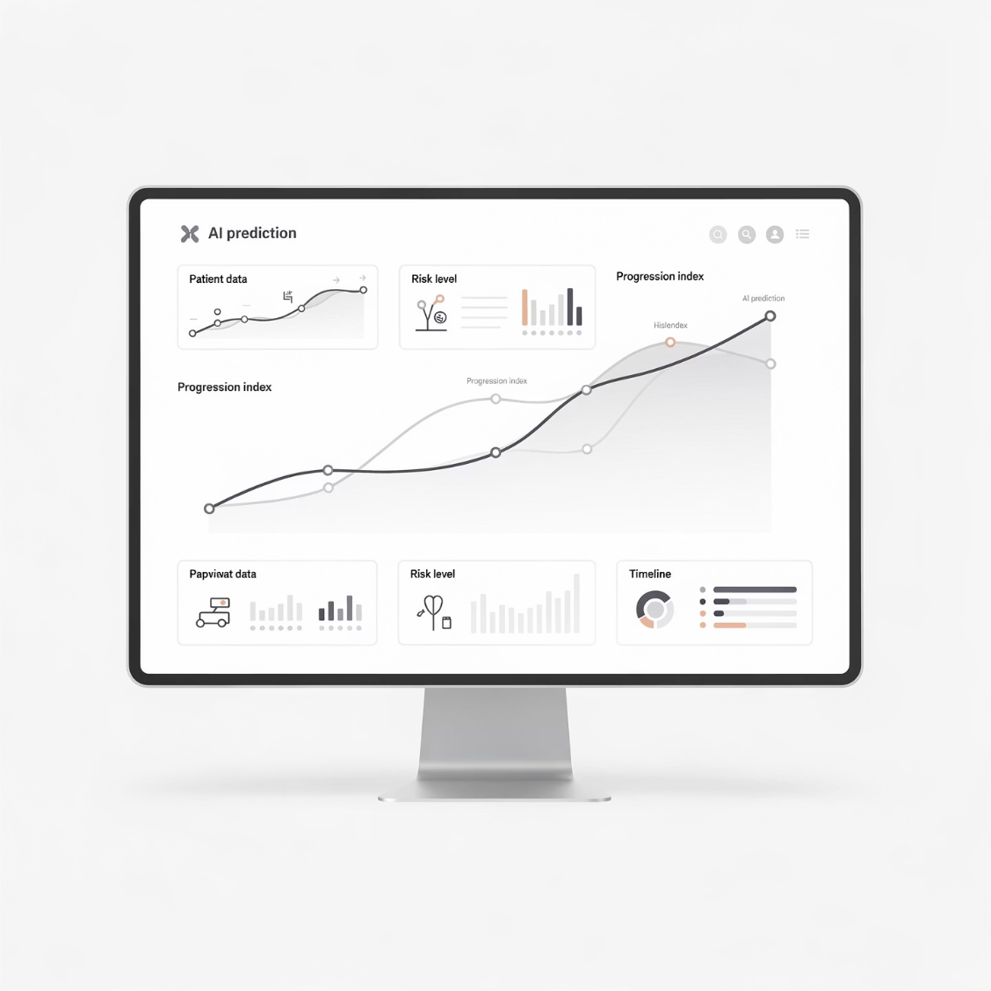

Medical Modeling Applied to Prediction
Medical modeling provides powerful predictive capabilities that transform how physicians understand disease progression and treatment outcomes.
For diseases without cures, modeling generates probabilistic predictions of disease evolution. Degenerative conditions like Alzheimer's, Parkinson's, and ALS can be tracked with unprecedented precision.
Baseline Analysis
Therapy Application
Initial disease state characterized at molecular level
Treatment options are evaluated and implemented
1
2
3
4
Progression Modeling
Adaptive Refinement
AI predicts multiple disease evolution scenarios
Models continuously update with new patient data
Adaptive Treatment: When therapy is provided, modeling predicts various disease management scenarios, enabling physicians to adapt treatment options as new information emerges.

Slide 7

AI-POWERED
New Generation of AI Applied to Medical Modeling
Cutting-edge AI and computational analysis transform medical modeling into an extraordinarily powerful diagnostic and therapeutic tool.
Generative AI & Machine Learning
Comparative Analysis
GenAI, ML, and deep learning techniques process complex medical data, identifying patterns across millions of data points
Individual patient data is cross-referenced against comprehensive medical databases to evaluate specific pathologies
Therapy Identification
Predictive Modeling
AI algorithms identify optimal therapy options, including novel treatments uniquely suited to each patient
AI forecasts disease progression both with and without therapeutic interventions, enabling informed decision-making

Slide 8

Modern Medicine Becomes Preemptive
AI-driven medical modeling elevates medicine beyond personalized and predictive approaches to become truly preemptive.
Advanced modeling and analytics identify chronic diseases at the molecular level before symptoms manifest, enabling intervention before patients experience illness.
Molecular Detection
Preemptive Solutions
Complex Pathology Resolution
Chronic diseases identified before clinical expression through molecular signatures
Therapeutic interventions deployed before patients experience any symptoms
Only this generation of medicine can precisely identify and solve intricate, multi-factorial diseases
"The future of medicine isn't just treating disease – it's preventing disease before it begins."

Slide 9

PROPRIETARY TECHNOLOGY
Gemini's Proprietary Modeling Technologies
Gemini has developed patent-pending proprietary technologies that power the next generation of personalized, predictive, and preemptive medicine.
Multi-Modal AI Integration
Therapeutic Optimization
Continuous Innovation
We deploy over a dozen different Generative AI and Deep Learning techniques, including several novel approaches developed in-house, to analyze illnesses at the molecular level
Our AI technologies identify optimal therapeutic options for each individual patient, including novel therapies tailored to specific illness profiles
Our research team constantly refines and expands our AI capabilities to address emerging medical challenges with unprecedented precision
Competitive Advantage: Gemini's proprietary algorithms represent years of specialized medical AI research, creating significant barriers to entry for competitors.

Slide 10




Gemini's Unified Software Fabric
Gemini uniquely integrates advanced medical modeling with intelligent software agents, patient relationship management, and enterprise-grade data security into a single, comprehensive platform.
AI Health Agents
Medical Modeling
Personal co-pilots for data collection, analysis, and model-building
Advanced algorithms for diagnosis and treatment planning
Data Security & Records
Patient Relationship Management
HIPAA-compliant health record management
Seamless patient-doctor connections and education
This unified software fabric becomes the core operating system for next-generation clinical medicine.

Slide 11




REAL-WORLD IMPACT
Applications of Gemini's Technologies
Complex Medical Challenges
Gemini applies modeling, AI, and software technologies to the most challenging medical conditions:
Oncology (cancer diagnostics and treatment)
Cardiovascular disease management
Neurodegenerative disorders
Chronic illness optimization
Genetic disorders
Autoimmune conditions
10%
65%
50%
Phase III Success Rate
Precision Drug Success
Cost Reduction
Traditional drug development approach
Molecular evidence-based therapies
Clinical trial efficiency improvement
Precision Drug Clinical Trials: Our technologies dramatically accelerate treatment development and substantially reduce clinical trial costs. With molecular evidence, precision drugs achieve 65% FDA approval rates versus just 10% for traditional approaches.

Slide 12
Gemini's Proprietary Technologies are Revolutionary
Our technologies place medical modeling at the center of every physician's practice, increasing efficiency, precision, equity, and productivity.
Increased Efficiency
Enhanced Precision
Optimized Longevity
Cut costs and save time during critical doctor shortages and price inflation
Medical modeling enables molecular-level diagnosis and treatment optimization
Maximize healthy lifespan and wellness years
These novel technologies represent a revolution in medicine – moving beyond reactive care toward a new era of personalized, predictive, and preemptive medicine.

Slide 13


Leadership Team
Gemini is led by visionary executives combining deep medical expertise with cutting-edge technology leadership.
Neal Solomon
Farron Rucker
Founder & Chief Executive Officer
Chief Technology Officer
Pioneering healthcare innovator with decades of experience in developing intelligent healthier technology solutions
Leading development of proprietary AI algorithms and unified software platform architecture

