Slide 1

Gemini Corp.
Intelligent Healthcare Solutions
2026 Business Summary
One Sansome Street, Suite 1400
San Francisco, CA 94104
(415) 334-5600
Founder and CEO: Neal Solomon
www.geminimedicalsolutions.com
info@geminimedicalsolutions.com

Slide 2

OUR VISION
Pioneering the Future of Personalized Medicine
Nearly all major medical problems in the future will involve computational or AI solutions.
Gemini solves complex challenges in clinical medicine by supplying patient-centered digital models and artificial intelligence that enable the next generation of truly personalized healthcare. We're not just adapting to the future of medicine—we're actively building it.
AI-Powered Medical Modeling
Intelligent Software Agents
Personalized Solutions
Automated assistants that enhance physician capabilities and streamline workflows
Tailored diagnostics and therapeutics designed for individual patient needs
Advanced computational frameworks that transform patient data into actionable insights
Our cloud-based subscription platform delivers cutting-edge technologies directly to doctors and medical researchers, transforming how healthcare professionals approach advanced diagnostics and personalized therapeutic solutions. Gemini represents the convergence of computational power, medical expertise, and patient-centered care.

Slide 3




HEALTHCARE TRANSFORMATION
Challenges of 21st Century Clinical Medicine
Modern healthcare faces unprecedented complexity. Physicians must navigate an explosion of medical data, rapidly evolving treatment options, and increasing demands for personalized care—all while managing time constraints and resource limitations. The traditional approaches to clinical medicine are reaching their limits.
Enhanced Diagnostics
How can physicians apply artificial intelligence to more accurately diagnose patient pathologies and identify conditions earlier in their progression?
Personalized Medicine
How can physicians develop patient-centered intelligent healthcare solutions that truly deliver on the promise of personalized medicine?
Digital Healthcare Platform
How can a comprehensive digital healthcare platform help doctors and researchers solve medical problems, optimize therapies, and efficiently improve patient outcomes?
Healthcare Optimization
How can digital technology automate, simplify, customize, consolidate, and optimize every aspect of patient healthcare delivery?
These questions represent the frontier of modern medicine. Gemini's technologies provide comprehensive answers, bridging the gap between clinical challenges and cutting-edge computational solutions.

Slide 4

OUR TECHNOLOGY
Gemini's Technology Solutions
Gemini develops revolutionary solutions through an intelligent digital healthcare SaaS platform that applies artificial intelligence to modeling and software agents. Our approach optimizes personalized diagnostics and therapeutics, empowering physicians and medical researchers with unprecedented capabilities.
"Gemini" means twins and refers to Digital Twins—a novel modeling approach that creates comprehensive digital representations of biological systems and patient-specific conditions.
Core Technology Pillars
01
02
03
Medical Digital Twins Modeling Services
Personal Health Assistants (PHAs)
Patient Relationship Management (PRM)
Digital Twins for diagnostics enable doctors to identify and predict patient diseases with remarkable precision, while therapeutics-focused Digital Twins tailor and optimize therapy solutions for each individual patient's unique biological profile.
AI-powered smart agents that serve as physician co-pilots, automating medical data collection, building and analyzing Digital Twin models, connecting doctors with patients, and personalizing healthcare experiences at scale.
Comprehensive management tools that help physicians and patients schedule contacts, anticipate critical events, and maintain continuous care coordination—all enhanced by Personal Health Assistant capabilities.
Gemini's integrated toolkit supplies physicians with technologies that have the genuine potential to revolutionize clinical medicine practice. By combining advanced modeling, intelligent automation, and seamless integration, we're creating a new paradigm for healthcare delivery.

Slide 5
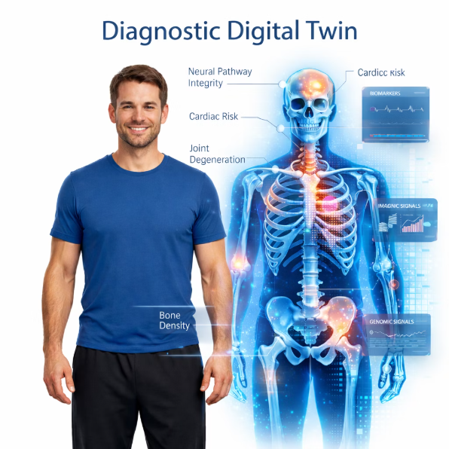
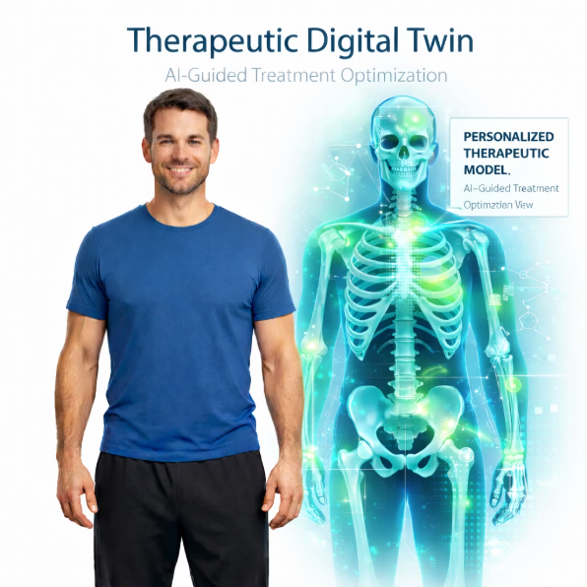



DIGITAL TWIN TECHNOLOGY
Gemini's Medical Digital Twins Technologies
Many diseases originate at the genetic level and demand targeted precision medicine solutions. Gemini's Digital Twins technology leverages genomic, proteomic, and multiomic biomarker data to inform sophisticated models and simulations that transform how we understand and treat disease.
Diagnostic Digital Twins
Therapeutic Digital Twins
Our diagnostic modeling enables:
Our therapeutic modeling facilitates:
Identification and analysis of pathology anatomy, mechanics, and origins
Prediction of pathology development scenario probabilities
Early detection of disease markers before clinical symptoms appear
Selection and adaptation of personalized treatment options
Identification and testing of customized remedies through advanced drug discovery
Optimization of chronic disease management protocols
Comprehensive Modeling Capabilities
Gemini applies Digital Twins and AI/ML across multiple biological scales—from molecular interactions (genes, RNA, proteins) through cellular dynamics, organ systems, and complete biosystems. This includes sophisticated drug modeling and simulations that bridge basic research with clinical applications.
Cardiovascular
Oncology
Advanced modeling for heart disease diagnostics and treatment optimization
Precision cancer diagnostics and personalized therapeutic strategies
Neurology
Immunology
Neurological disease modeling and treatment pathway analysis
Infectious disease modeling and immune response optimization
Genetics
Metabolic
Genetic disease identification and targeted therapy development
Metabolic disorder analysis and chronic disease management
Each patient's Digital Twin model is continually updated and tracked, creating a living digital medical version of each individual. This enables powerful comparisons between diseased and healthy models, facilitating breakthrough insights into disease progression and treatment efficacy. Gemini has developed its own advanced proprietary Digital Twins system architecture—a foundation for the next generation of clinical practice.

Slide 6

SYSTEM ARCHITECTURE
Gemini Proprietary Medical DT System Architecture
Gemini's seminal patent portfolio on medical Digital Twins elucidates the central features defining the next generation of clinical medicine: the powerful combination of Medical DT modeling with advanced AI/ML capabilities. Our modular architecture represents years of research and innovation distilled into a practical, scalable system.
Diagnostics Architecture
Therapeutics Architecture
Levels 1-6: From Patient Data to Prognosis
Levels 7-12: From Treatment to Population Health
Level 1: General Patient Model
Level 7: General Therapy Solutions
Comprehensive patient data integration and baseline modeling
Broad therapeutic option identification
Level 2: Bioinformatics Analysis
Level 8: Unique Therapy Genesis
Advanced computational analysis of biological data
Creation of patient-specific treatment approaches
Level 3: Molecular & Cellular Description
Level 9: Therapy Testing
Detailed characterization at molecular and cellular levels
Simulation and validation of treatment options
Level 4: Pathology Identification
Level 10: Therapy Prediction
Structural genetic combination pathology detection
Outcome scenario modeling and optimization
Level 5: Pathology Diagnosis
Level 11: Unified Patient Model
Functional molecular and cellular diagnosis
Comprehensive individual health representation
Level 6: Diagnostic Prognosis
Level 12: Population Model
Predictive simulation of disease progression
Aggregated insights across patient populations
This systematic, modular architecture enables physicians and researchers to deploy precisely the capabilities they need for each clinical scenario, from initial diagnosis through long-term treatment monitoring and population health management.

Slide 7
INTELLIGENT ASSISTANTS
Personal Health Assistants & Patient Relationship Management
Personal Health Assistants: AI-Powered Clinical Co-Pilots
Personal Health Assistants represent the cutting edge of generative AI, machine learning, and natural language processing applied to healthcare. These intelligent agents function as sophisticated co-pilots for physicians and medical researchers, dramatically enhancing productivity and clinical decision-making.
Physician Support (GMS)
Research Support (GRS)
Workflow Automation
PHAs assist physicians with diagnostics and therapeutics modeling, solving complex problems and generating evidence-based solutions within the Digital Twins framework.
PHAs enable medical researchers to conduct advanced therapeutics modeling, accelerating drug discovery and treatment development.
PHAs automate routine functions, from data collection to EMR/EHR management, allowing healthcare professionals to focus on patient care.
Patient Relationship Management: Unified Care Coordination
The patient journey is typically a labyrinth of confusing, ad hoc, and disaggregated doctor appointments and diagnostic testing contacts. Gemini's PRM tools, automated by Personal Health Assistants, transform this fragmented experience into a seamless, coordinated care pathway.
PRM Categories
Security & Privacy
Analytical: Data-driven insights into patient health trends
Patient Management: Appointment scheduling and care coordination
Collaboration: Communication between healthcare team members
Operational: Workflow optimization and resource allocation
PHAs integrate robust data security and privacy protections through advanced encryption and granular permission controls, ensuring patient information remains secure while enabling seamless care coordination.

Slide 8

INTELLECTUAL PROPERTY
Gemini Intellectual Property
Gemini's intellectual property portfolio represents the culmination of groundbreaking research in medical Digital Twins, artificial intelligence applications, and computational medicine. Our patents establish a strong competitive moat and position Gemini as the definitive leader in this emerging field.
April 2024: Foundational Patent
Filed comprehensive 20,000-word provisional patent application covering multi-level medical Digital Twin architecture—establishing core framework
August 2024: Expanded Patent Portfolio
Filed robust 50,000+ word omnibus provisional patent application significantly expanding the medical modeling system
Key Innovations in August 2024 Filing
Modular Architecture
AI Integration
Advanced architecture featuring a modular periodic table of 80+ medical model categories and their dynamic interactions—unprecedented in scope and sophistication
Application of dozens of GenAI/ML/DL sub-types to medical modeling, plus original AI techniques for prediction and drug design categories
Drug Discovery
Bio-Simulations
Novel methods for in silico experiments enabling accelerated drug discovery and synthetic drug design
Cutting-edge 3D and 4D biological simulations for molecular/cellular diagnostics, prognostics, and therapeutics
Disease Applications
Clinical Trials
AI-based Digital Twins applications for cardiovascular, cancer, neurological, autoimmune, and genetic pathologies
Revolutionary applications of Digital Twins to drug clinical trials and preemptive medicine strategies
Founder Expertise: Gemini's founder and CEO, Neal Solomon, invented these pioneer technologies and holds patents in related domains including medical devices, bioinformatics, artificial intelligence, and database systems.
Gemini Labs maintains an active in-house R&D program continuously building upon our digital health technology foundation. Our commitment to innovation ensures we remain at the forefront of computational medicine.
SEE: GEMINI TECHNOLOGY NOVELTIES DECK

Slide 9

PHYSICIAN SOLUTIONS
Gemini Medical Solutions
Physician Subsidiary—Empowering Doctors with Advanced Technology
Gemini Medical Solutions (GMS) delivers a comprehensive digital platform that applies our advanced toolkit to enable member physicians to solve complex clinical problems. Our flexible subscription model allows doctors to tailor services to fit their specific needs and budget constraints.
Core Platform Capabilities
Diagnostic Modeling & Analytics
Therapeutic Optimization
Digital Twin modeling tools for patient pathology diagnostics and prognostic predictions—identifying diseases earlier and more accurately
Build Digital Twin models to identify optimal patient therapy options tailored to individual biological profiles
Personal Health Assistants
Patient Relationship Management
AI-powered assistants that deliver personalized medicine solutions and enhance physician productivity
Unified technology solutions that streamline patient care coordination and experience
Physicians customize services through basic subscriptions plus à la carte options, ensuring they pay only for the capabilities they need.
Partner Referral Network
GMS facilitates valuable networking opportunities between member doctors and strategic business partners, creating a comprehensive healthcare ecosystem:
Clinical Referrals
Industry Partnerships
Diagnostic Services
Connect internists with specialists
Facilitate multi-disciplinary consultations
Link doctors to bio/pharma companies
Connect patients with pharmacies
Genomic testing companies
Computational analysis services
Future subsidiary divisions—Gemini Research Solutions (GRS) for medical researchers and Gemini Enterprise Solutions (GES) for hospital corporate customers—will launch in Phase B, expanding our market reach and impact.

Slide 10
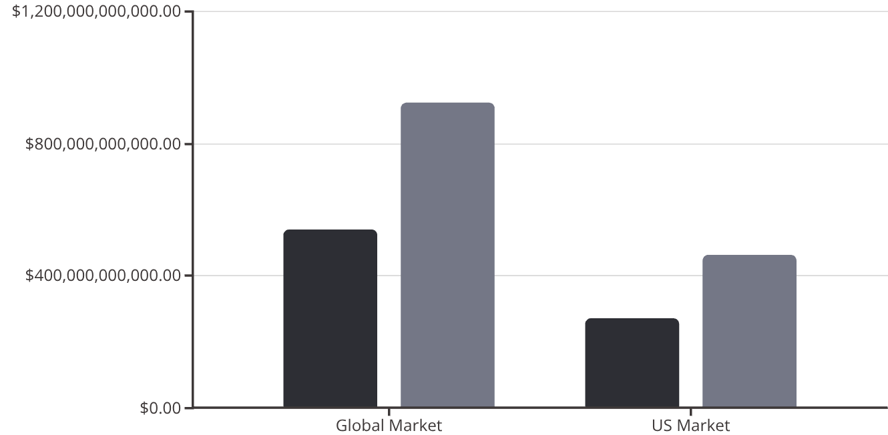

MARKET ANALYSIS
Personalized Medicine Market & Competitor Analysis
Explosive Market Growth
$925B
The personalized medicine market is experiencing unprecedented expansion, driven by advances in genomics, AI, and digital health technologies. This represents a massive opportunity for innovative platforms like Gemini.
Projected 2030 Market
Global personalized medicine market size
39%
FDA Approvals
2021 drug approvals involving personalized medicines
2022
2030 (Projected)
Competitive Landscape Analysis
The market for digital personalized medicine and intelligent healthcare is nascent, fragmented, and experiencing rapid growth, driven by emerging AI and Digital Twins technologies. While several well-funded companies operate in related spaces, none directly compete with Gemini's comprehensive physician-focused platform.
Medable ($500M)
Paige ($220M)
Paradigm ($203M)
Clinical research and predictive medicine platform
Software for treatment identification
Platform for drug clinical trials
Twin Health ($200M)
Unlearn.ai ($130M)
Hippocratic AI ($120M)
IoT sensors and AI for metabolic diseases
Digital Twins for health record analysis
GenAI agent nurses for patient advice
Gemini's Competitive Advantage: None of these companies are direct competitors—each focuses on different niches. Gemini's comprehensive Digital Twin modeling and AI tools fill a critical market gap, representing the centerpiece of advanced clinical practice and the emergence of functional personalized medicine.
SEE: MARKET COMPETITION ANALYSIS (65+ VENTURES)

Slide 11
VALUE PROPOSITION
Gemini's Superior Value Propositions
Gemini delivers unmatched value across technology, economics, and market positioning—creating a compelling investment opportunity and transformative solution for healthcare providers.
Technology Superiority
Value Superiority
Market Superiority
Integration & Simplification
Quality at Optimal Cost
Addressing Physician Shortages
Our digital healthcare platform with Digital Twin modeling, software agents, and PRM technologies supplies on-demand modular tools that integrate and simplify clinical medicine practice. Unlike competitors offering point solutions, Gemini provides a comprehensive ecosystem.
We maximize customer value by delivering quality health services at a superior cost proposition. Our subscription model ensures physicians receive exceptional ROI.
With critical doctor shortages nationwide, our advanced technologies enhance physician productivity and efficiency—allowing each doctor to serve more patients without compromising care quality.
Customization & Automation
Gemini provides compelling automation tools to unify, customize, and optimize patient experiences through a flexible subscription model. Physicians tailor only the services they need, avoiding unnecessary costs.
Market Integration
Precision Medicine Solutions
Given extensive market fragmentation, Gemini supplies critical tools to integrate clinical medicine practice, creating a unified platform that replaces disparate point solutions.
Digital Twins modeling for diagnostics and therapeutics delivers genuine precision medicine—far superior to simple symptom-based AI diagnostics offered by competitors.
Financial Benefits
Democratizing Healthcare
Competitive Moat
Our services are partly deductible for tax benefits and health insurance reimbursement, enhancing overall customer value and reducing the effective cost of adoption.
We democratize healthcare by decentralizing power in the healthcare system, returning control to doctors and patients rather than institutional bureaucracies.
Medical Digital Twins have high technical barriers to entry. Combined with our strong intellectual property portfolio, this provides sustainable competitive advantage that protects market position.

Slide 12
GO-TO-MARKET
Sales Strategy
Gemini operates as a technology company selling advanced Digital Twin and AI solutions that solve critical clinical problems. Our SaaS-based subscription model provides recurring revenue while delivering exceptional value to physicians and medical researchers.
Revenue Model Architecture
Core Subscriptions (GMS)
Partner Referral Services
Physician subscriptions include basic monthly services with multiple service tiers:
Multiple partnership channels generate additional revenue:
Specialist physician referrals
Bio/pharma company connections
Pharmacy network partnerships
Genomic testing service partnerships
Computational analysis partnerships
Digital Twins: Multiple modeling levels for diagnostics, therapeutics, and prognostics
Personal Health Assistants: Tiered agent service levels s
Patient Relationship Management: Variable software service packages
Our à la carte structure enables physicians and researchers to tailor services precisely to their needs, ensuring optimal product-market fit.
Each partnership generates referral fees or revenue sharing arrangements.
SEE: GO-TO-MARKET STRATEGY & SALES PROJECTIONS

Slide 13
TARGET MARKET SEGMENTS
Target Market Segments
Individual Physicians
Physician Groups
Hospital Systems
Solo practitioners and small groups seeking competitive advantage through technology
Mid-size practices looking to standardize and enhance care delivery
Public, private, and university hospitals requiring enterprise solutions
Hospital Chains
Large healthcare networks seeking systematic technology deployment

Slide 14





INVESTMENT OPPORTUNITY
Financial Strategy
Seed Funding Round: $25M
Two-year runway to achieve key milestones and position for Series A. Seed Round investors receive priority funding opportunity at Series A ($125M), ensuring continued participation in Gemini's growth story.
Strategic Hiring Focus
Gemini's breakthrough technologies require world-class talent. The San Francisco Bay Area provides access to essential specialists in programming, AI/ML, computer modeling, and biomedical engineering. We project scaling to 80+ employees by year two of seed funding.
Development Roadmap
Seed funding supports comprehensive technology development: generating modeling infrastructure, building software agents, implementing AI capabilities, and creating robust software fabric. We'll simultaneously develop our initial research program and product pipeline.
Market Entry
Initiate Beta sales to select physicians, gathering critical feedback and refining our platform based on real-world clinical use. Simultaneously develop initial strategic partnerships to expand our ecosystem and referral network.
Talent Investment Breakdown
Technology Team
Scientific Team
Business Team
AI/ML Engineers
Software Developers
Platform Architects
DevOps Specialists
Biomedical Engineers
Computational Biologists
Clinical Advisors
Research Scientists
Sales & Marketing
Customer Success
Operations
Finance & Legal
Investment Opportunity: Gemini represents a unique opportunity to invest in the foundational platform for next-generation clinical medicine. Our comprehensive IP portfolio, experienced leadership, and enormous addressable market create exceptional potential for returns.
SEE: FINANCIAL STATEMENTS
SEE: PRODUCT DEVELOPMENT STRATEGY

